Slide 1

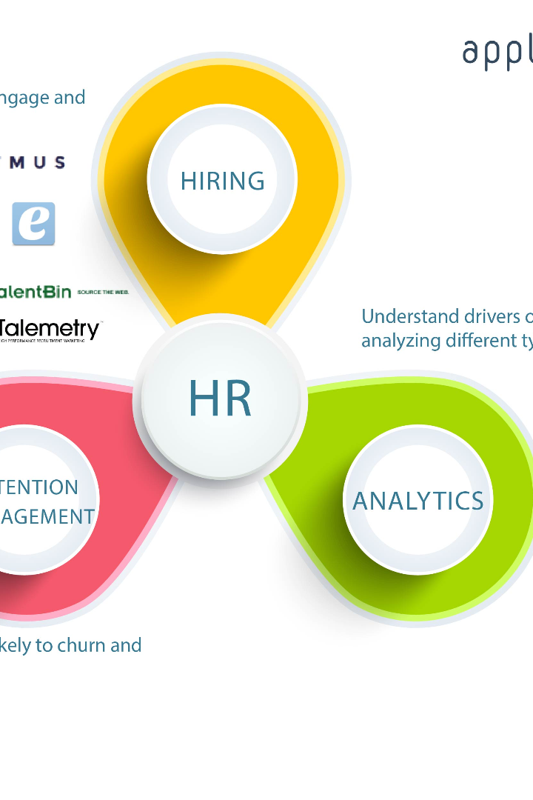
HR Analytics: Unveiling Insights for Business Success
HR analytics is a powerful tool that helps organizations gain valuable insights into their workforce. By leveraging data, we can optimize talent management strategies and drive business success.

Slide 2

Definition of HR Analytics
What is HR Analytics?
HR analytics is the process of utilizing data and statistical methods to gain insights into various HR metrics and make data-driven decisions to improve organizational performance.
Why is HR Analytics Important?
HR analytics enables HR professionals and leaders to identify trends, patterns, and correlations in people-related data, leading to more effective HR strategies and improved business outcomes.
Benefits of HR Analytics
HR analytics empowers organizations to make better-informed decisions regarding talent acquisition, performance management, employee engagement, and retention. It helps drive workforce productivity, reduce costs, and enhance overall organizational effectiveness.

Slide 3
Observations on Key HR Metrics
Average Attrition Rate for all Departments
Average Hourly Rate of Male Research Scientist
Attrition Rate vs. Monthly Income Stats
Average Working Years for Each Department
Examining the relationship between attrition and monthly income provides insights into whether compensation impacts employee retention and identifies potential areas for salary adjustment.
The attrition rate across all departments indicates the overall turnover within the organization. It provides insights into talent retention strategies and identifies areas for improvement.
The hourly rate for male research scientists sheds light on potential gender pay gaps and the value assigned to specific roles within the organization.
Understanding the average tenure in different departments allows for the identification of opportunities for career development and measures to retain experienced employees.

Slide 4
Conclusions on Key HR Metrics
1
Attrition Rate:
2
Gender Pay Gap:
The attrition rate for all departments is relatively high compared to industry benchmarks. Addressing this issue requires a comprehensive retention strategy to retain top talent.
An analysis of hourly rates reveals a significant pay gap between male research scientists and their female counterparts. Achieving pay equity should be a top priority.
3
Income and Attrition:
4
Employee Tenure:
A positive correlation exists between monthly income and attrition rate. Implementing fair and competitive compensation packages can help reduce turnover.
Different departments exhibit varying average working years, with higher tenure in technical roles. Creating growth opportunities and a clear career path can improve employee retention across all departments.
5
Work-Life Balance:
6
Promotions and Attrition:
Several job roles have a poor work-life balance, leading to decreased job satisfaction and potential burnout. Redesigning job roles and offering flexible work arrangements can help improve work-life balance.
A longer time since the last promotion is associated with a higher attrition rate. Implementing a structured career progression plan can boost employee engagement and reduce turnover.

Slide 5
Solutions for Identified HR Challenges
1
Focus on Retention Strategies
Implement targeted retention initiatives such as personalized professional development plans, mentorship programs, and competitive compensation packages to reduce attrition.
Promote Pay Equity
2
Conduct a thorough compensation analysis to identify and resolve gender pay gaps. Develop transparent pay policies and provide equal opportunities for career growth.
3
Revamp Performance Management
Enhance performance appraisal processes by introducing regular feedback sessions, setting SMART goals, and aligning individual objectives with organizational goals.
Invest in Employee Well-being
4
Offer wellness programs, flexible work arrangements, and initiatives that promote work-life balance. Foster an inclusive and supportive work environment to enhance employee satisfaction.

Slide 6
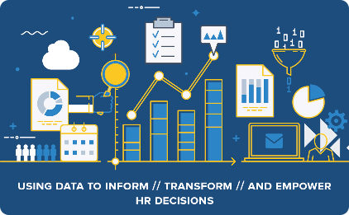
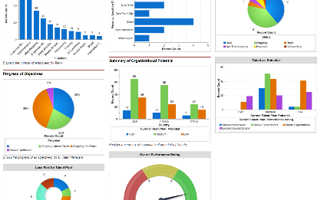
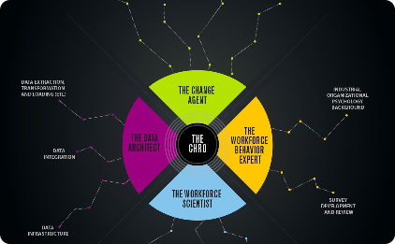
Unleash the Power of HR Analytics
Data-Driven Decisions
Insights for Organizational Performance
Cross-Functional Collaboration
With HR analytics, organizations can make data-driven decisions to optimize talent management strategies and drive overall business success.
Effective utilization of HR analytics requires collaboration among HR, data analytics teams, and business leaders to identify trends, patterns, and actionable insights.
HR analytics provides valuable insights into HR metrics, enabling organizations to enhance workforce productivity, reduce costs, and improve overall organizational effectiveness.

